Slide 1
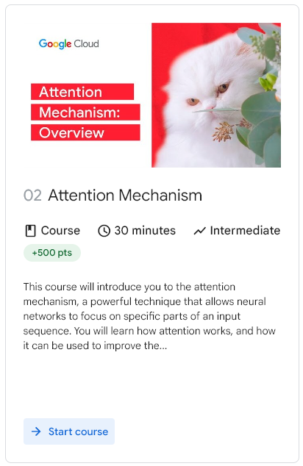

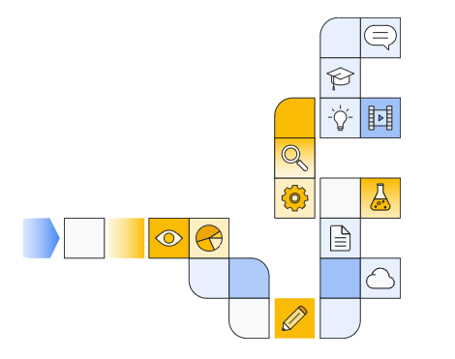

Notes:
https://www.cloudskillsboost.google/paths/183/course_templates/537

Slide 2
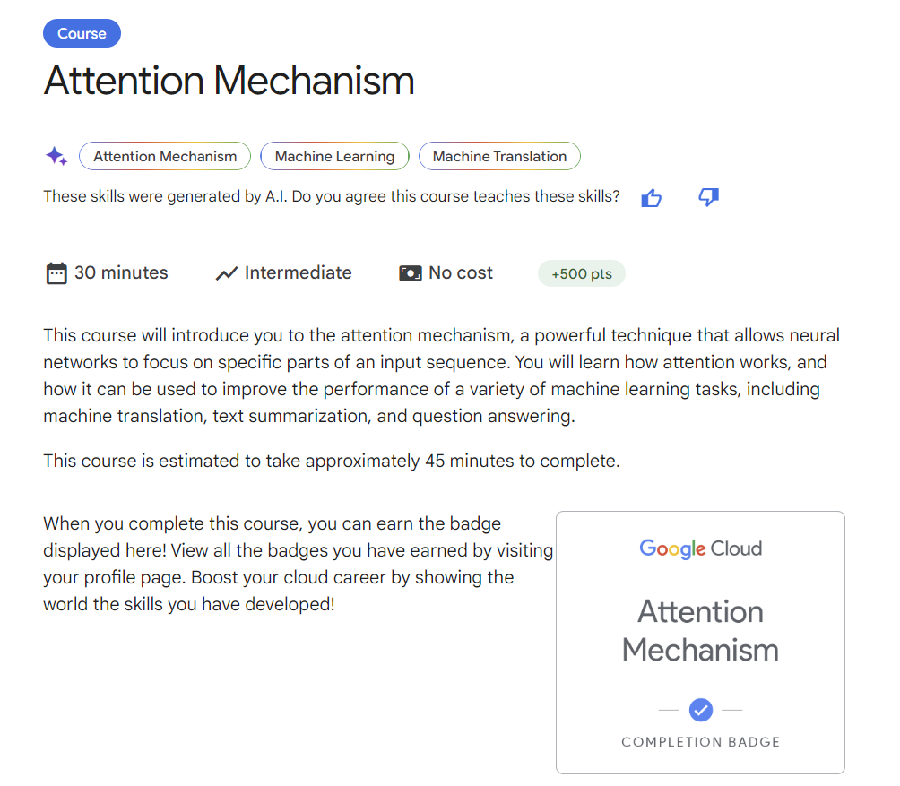
Notes:
https://www.cloudskillsboost.google/paths/183/course_templates/537

Slide 3
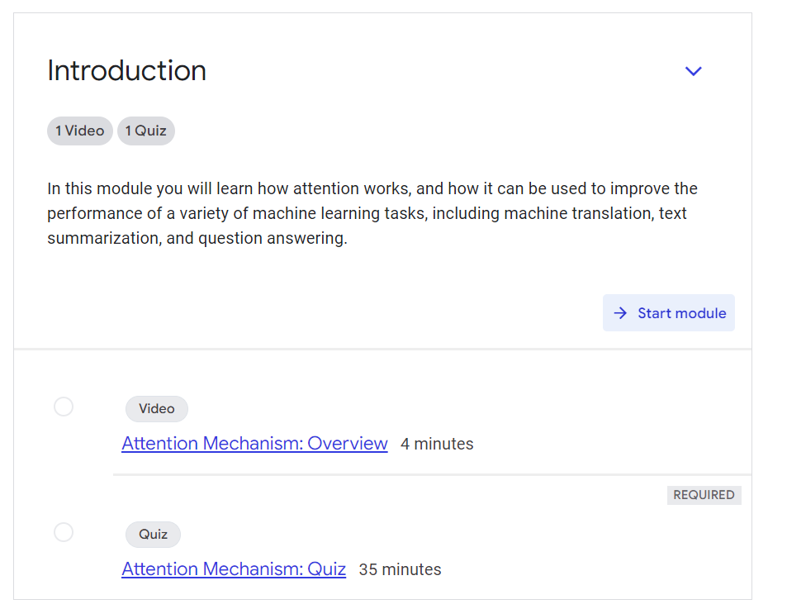
Notes:
https://www.cloudskillsboost.google/paths/183/course_templates/537

Slide 4
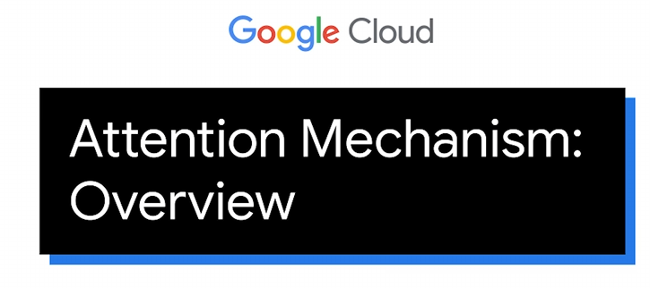

Slide 5
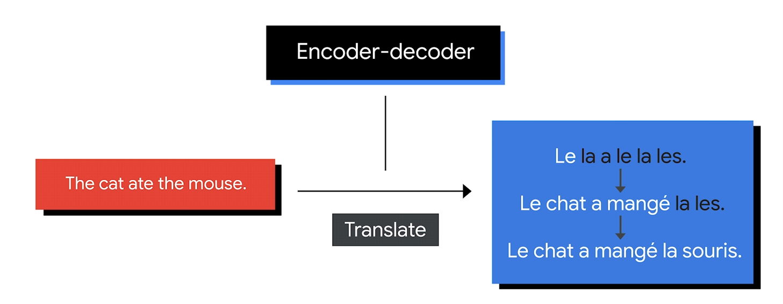

Slide 6
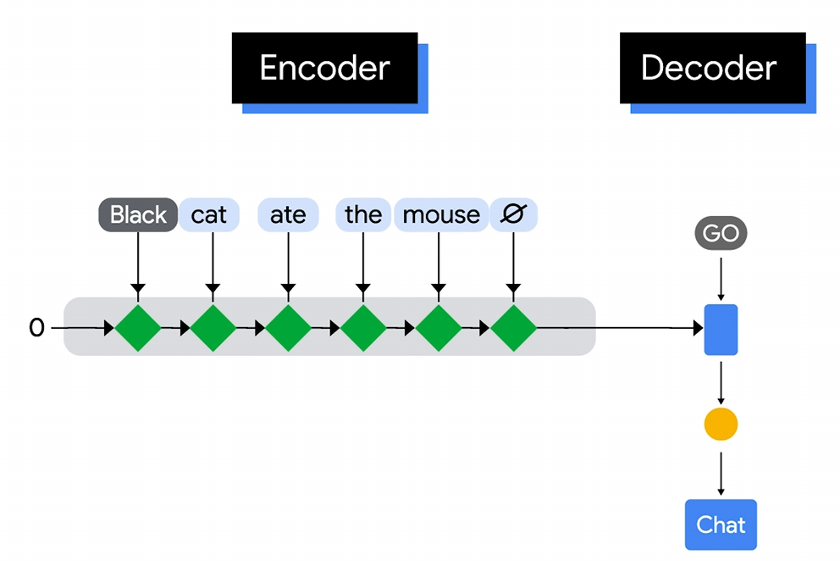

Slide 7
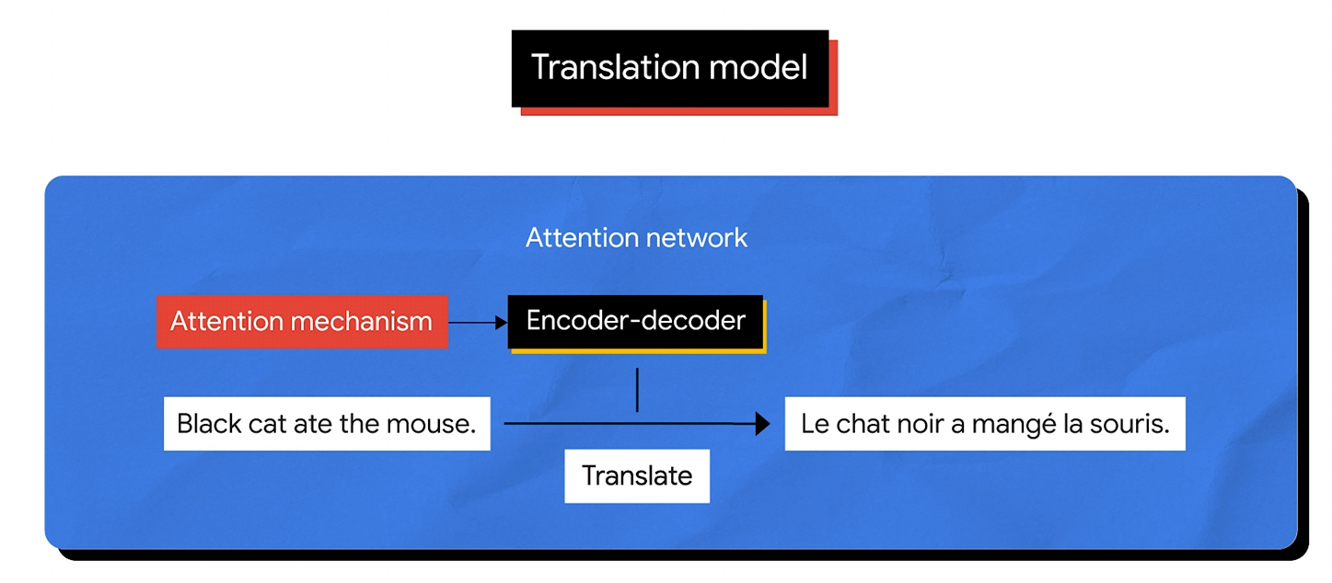

Slide 8
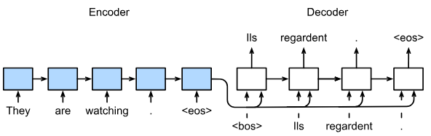
Classic Sequence-To-Sequence
Notes:
https://classic.d2l.ai/chapter_recurrent-modern/seq2seq.html

Slide 9
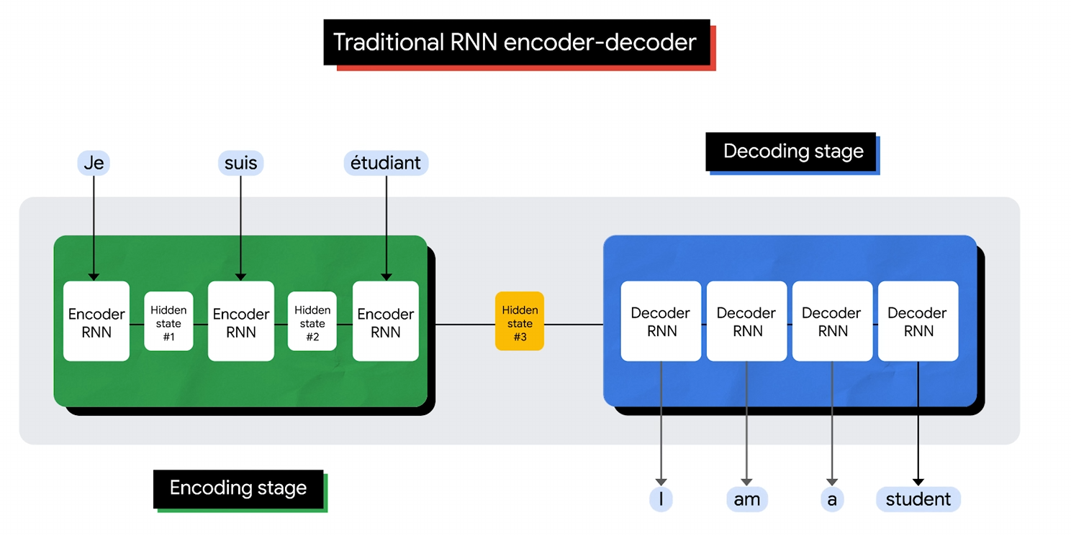

Slide 10
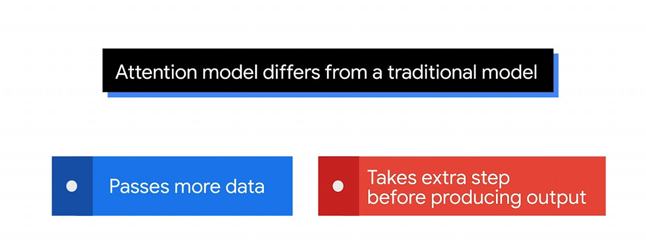

Slide 11
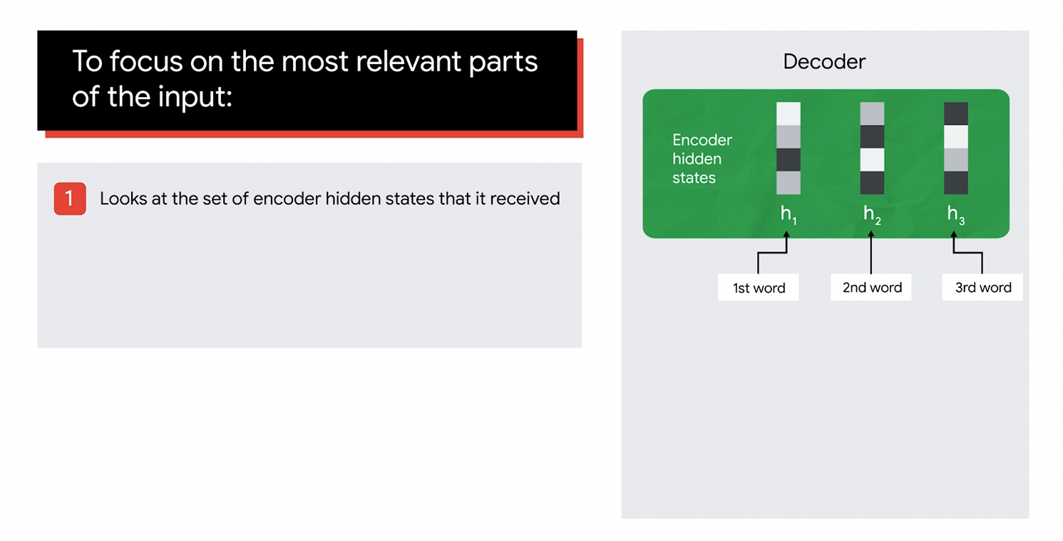

Slide 12
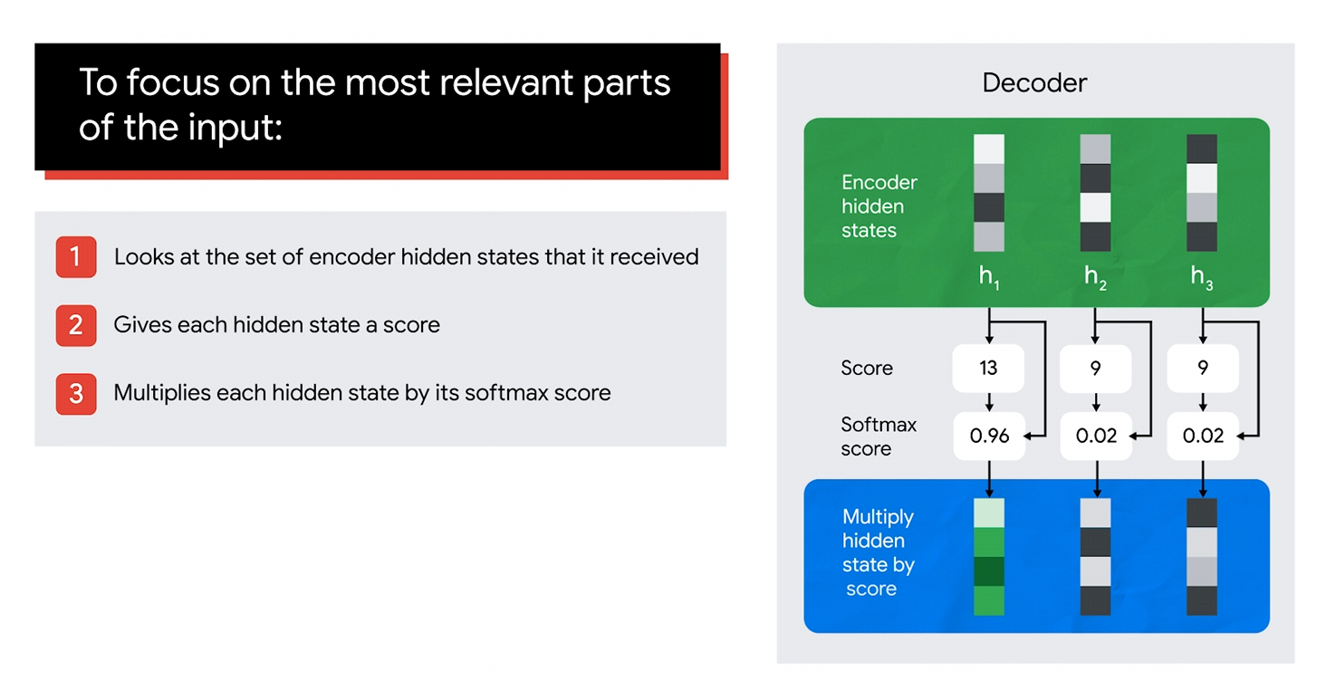

Slide 13
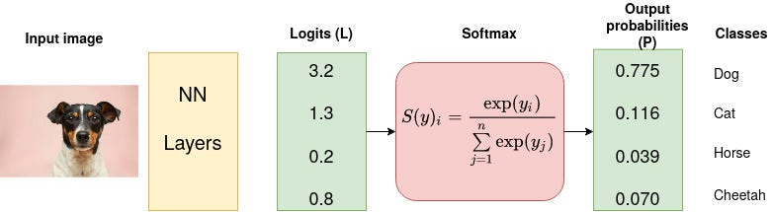
What is SoftMax?

Slide 14
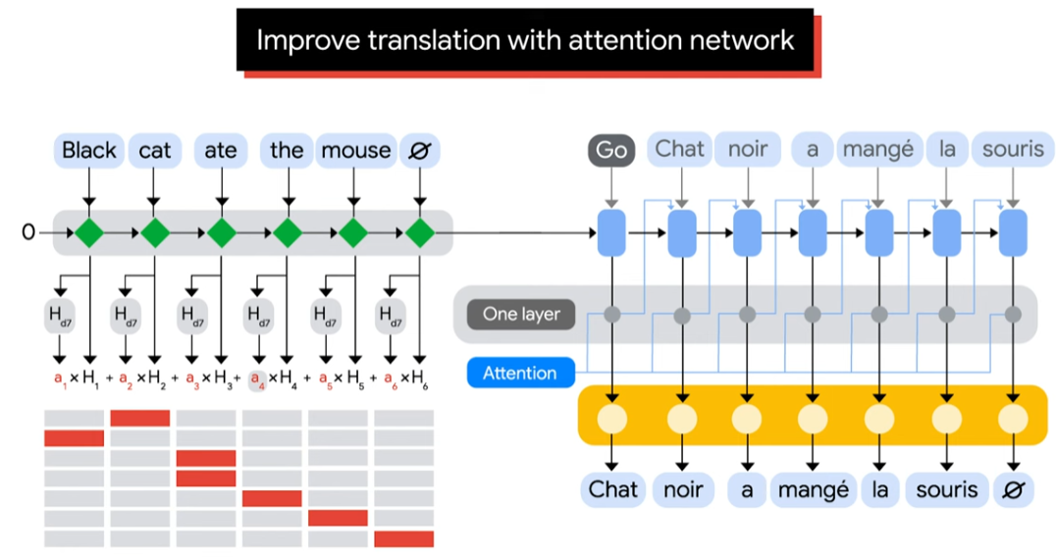

Slide 15
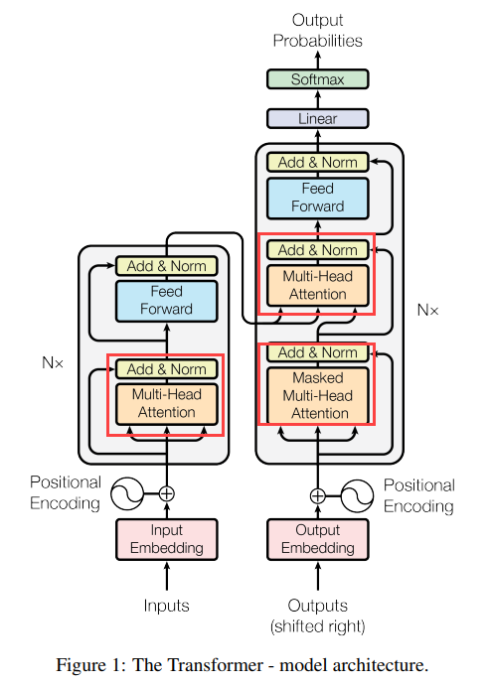
Notes:
https://arxiv.org/pdf/1706.03762

Slide 16
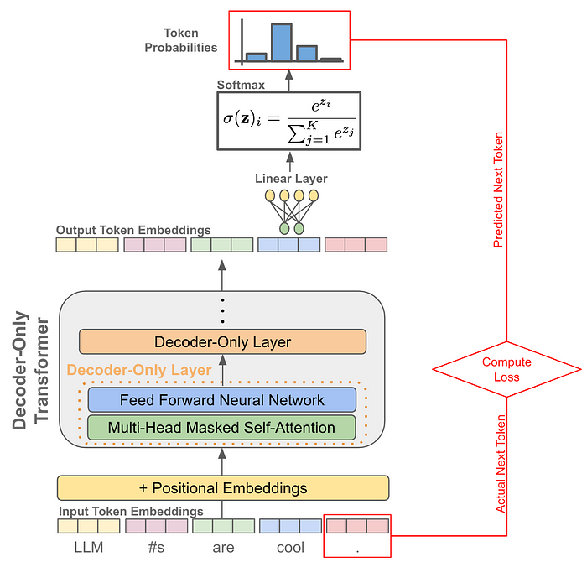
Notes:
https://medium.com/@akash.kesrwani99/understanding-next-token-prediction-concept-to-code-1st-part-7054dabda347

Slide 17
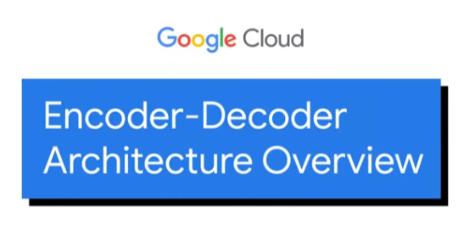
More context
https://www.youtube.com/watch?v=671xny8iows

Slide 18
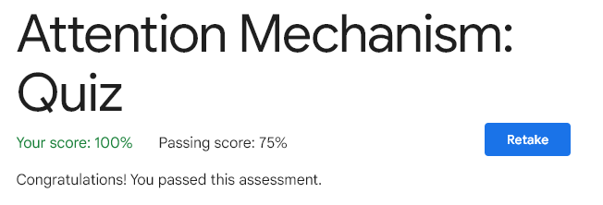

Slide 19


